Slide 1
Quantum search algothrithm
By Lov Grover 1995

Slide 2
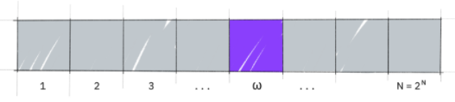

1. Problem
Given an unordered array of $m$ elements, find a particular element $x$.
Classical: brute-force requires $m$ queries (average $\frac{m}{2}$)
Quantum: grover’s algothrithm requires $√m$

Slide 3
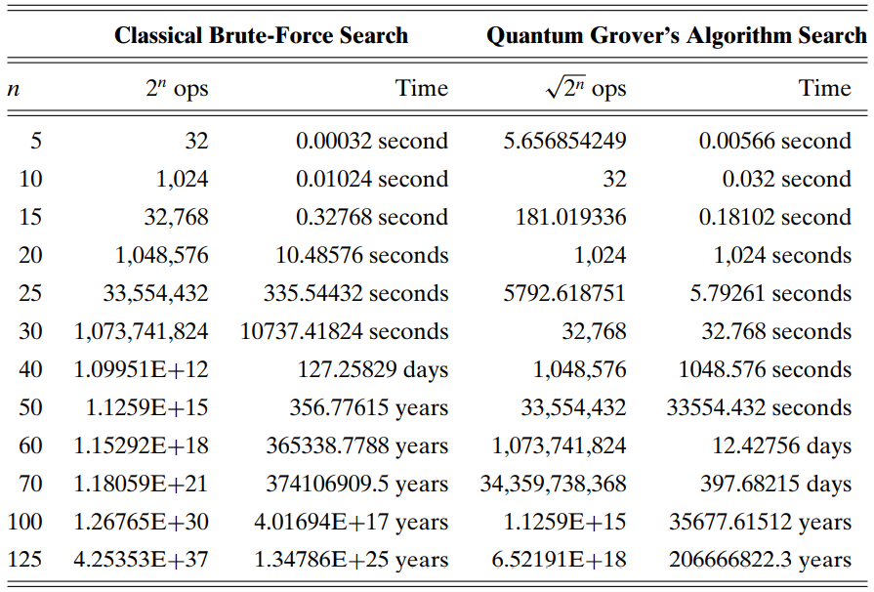

Slide 4
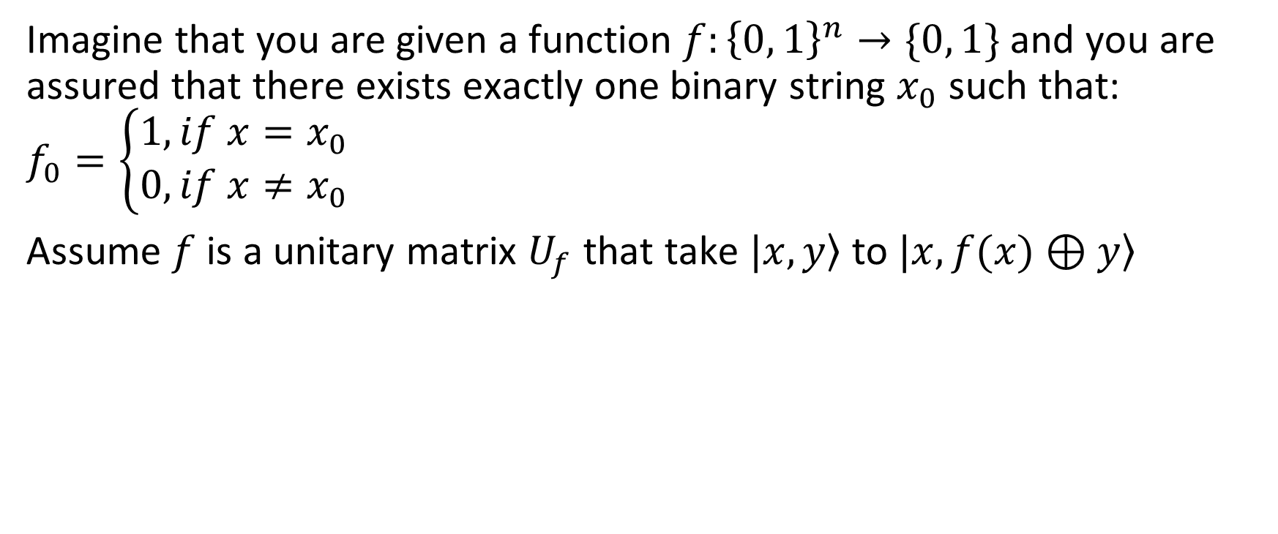
2. Algothrithm
Imagine that you are given a function $f:{\left\{0, 1\right\}}^{n}→\{0, 1\}$and you are assured that there exists exactly one binary string $x_{0}$ such that:
$$f_{0}=\left\{\begin{aligned}1,if x=x_{0} \\ 0, if x≠x_{0}\end{aligned}\right.$$
Assume $f$ is a unitary matrix $U_{f}$ that take $\left.|x,y\right\rangle$ to $\left.|x,f(x)⊕y\right\rangle$

Slide 5
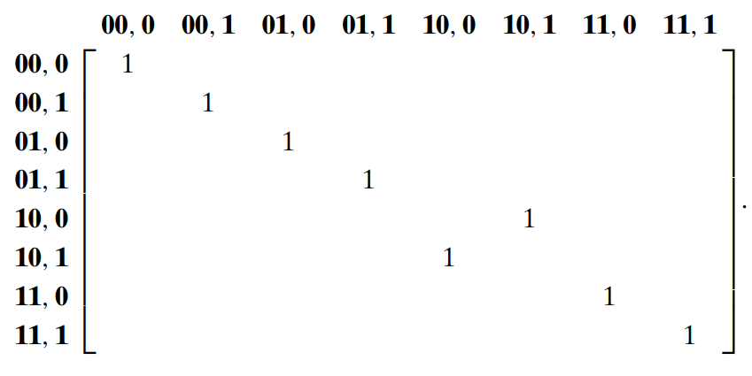
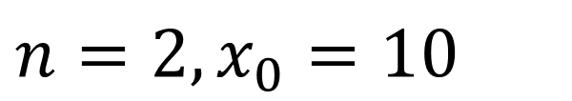
2. Algothrithm
$$n=2, x_{0}=10$$

Slide 6
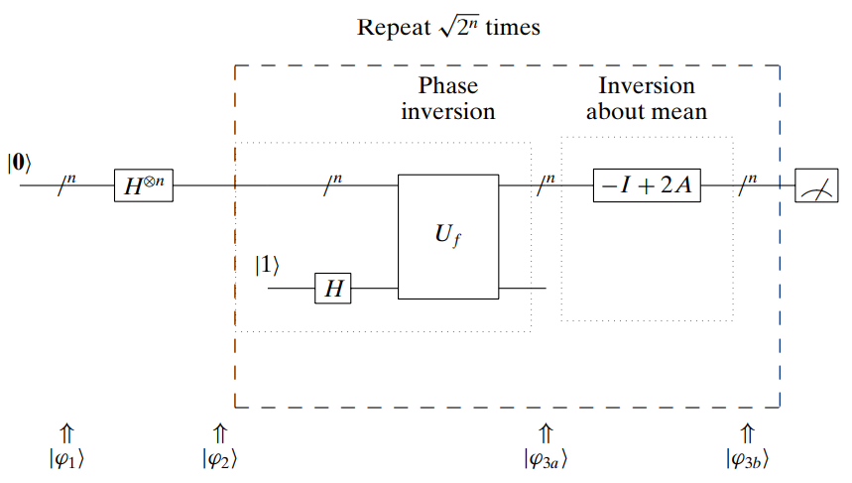
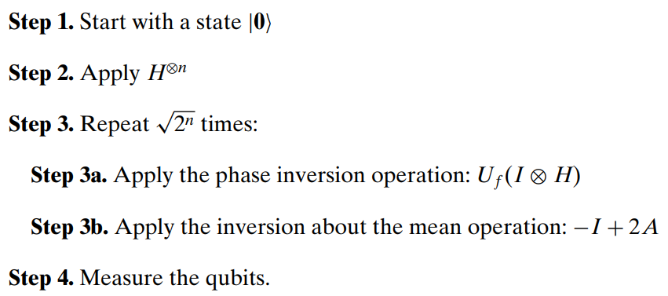
2. Algothrithm

Slide 7
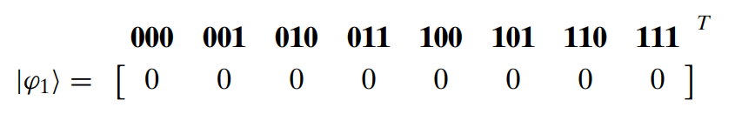
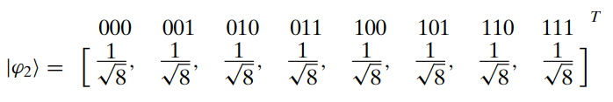
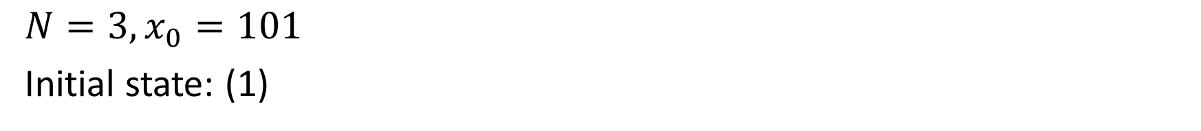
3. Example
$$N=3, x_{0}=101$$
Initial state: (1)
After apply $H^{⊕N}$ (2):

Slide 8
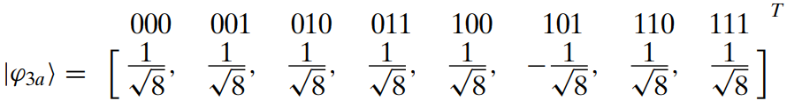
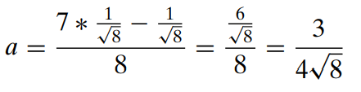
3. Example
After apply Phase inversion: (3a)
Calculate average of all elements in $\left.|φ_{3a}\right\rangle$ (3a)

Slide 9
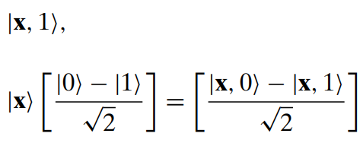

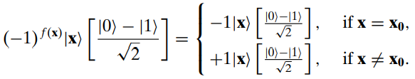

Slide 10
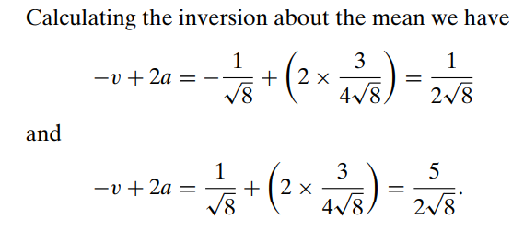
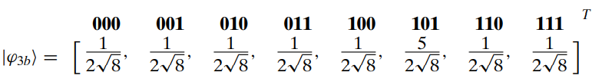
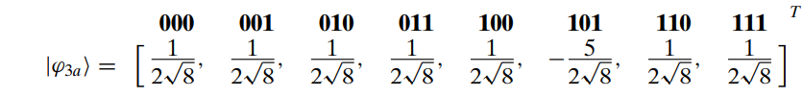

3. Example (iteration 1)
$$→$$
After phase inversion

Slide 11

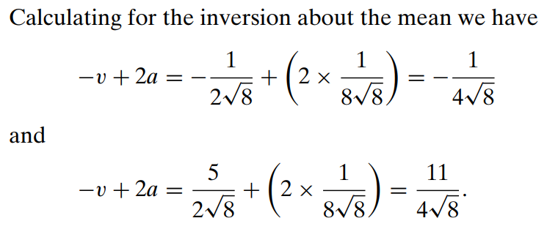
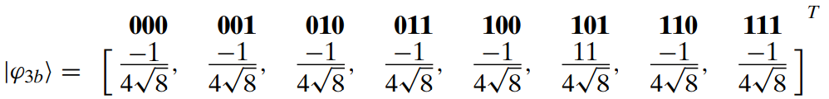
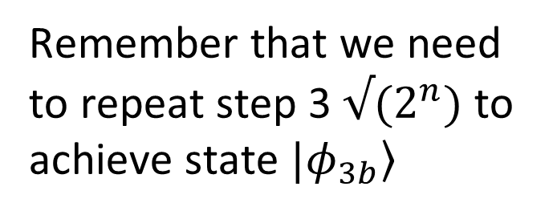

3. Example (iteration 2)
Remember that we need to repeat step 3 $√(2^{n})$ to achieve state $\left.|φ_{3b}\right\rangle$
$$→$$

Slide 12


3. Example
$$→$$
Measure:
$$p\left(\left.|101\right\rangle \right)={\left(\frac{11}{4\sqrt{8}}\right)}^{2}=0.9453=94.53\%$$
$$p\left(\left.|other\right\rangle \right)=\frac{{\left(\frac{−1}{4\sqrt{8}}\right)}^{2}}{7}=0.0078=0.78\%$$

Slide 13
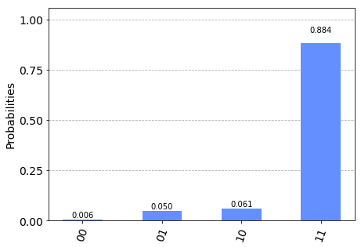

Slide 14
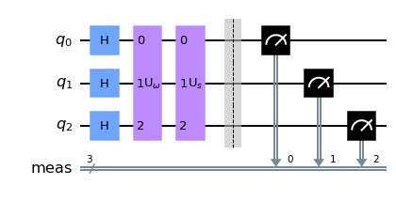
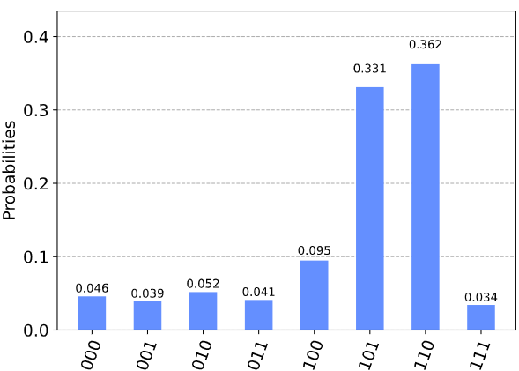
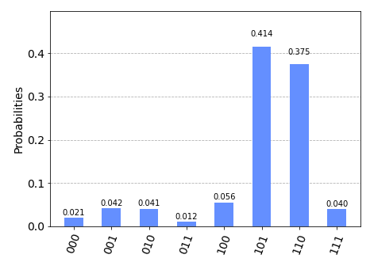

$$x_{0}=101 \& 110$$

Slide 15
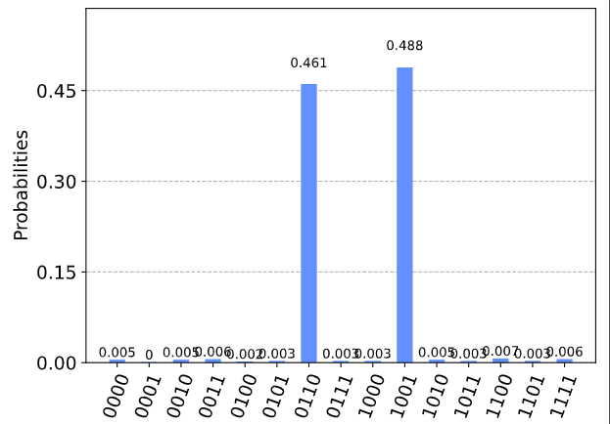

Excute on real device
$$x_{0}=0110 \& 1001$$

